Slide 1
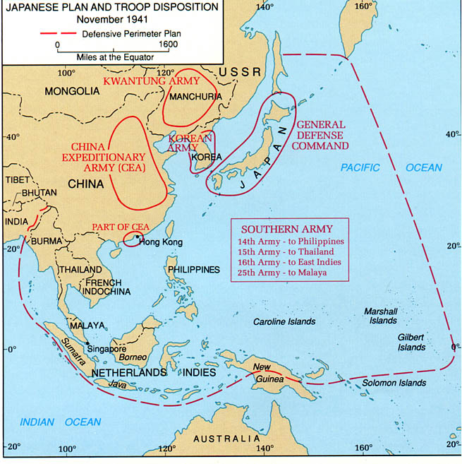
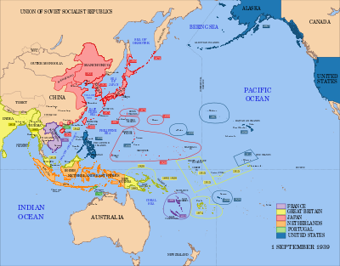
Complete Warm up on worksheet!

Slide 2
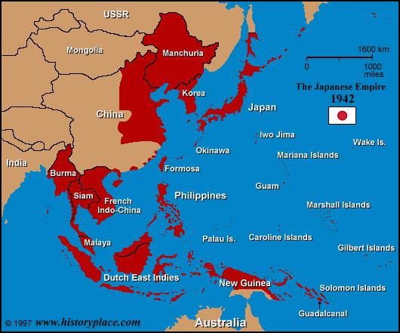
WAR IN THE PACIFIC!

Slide 3
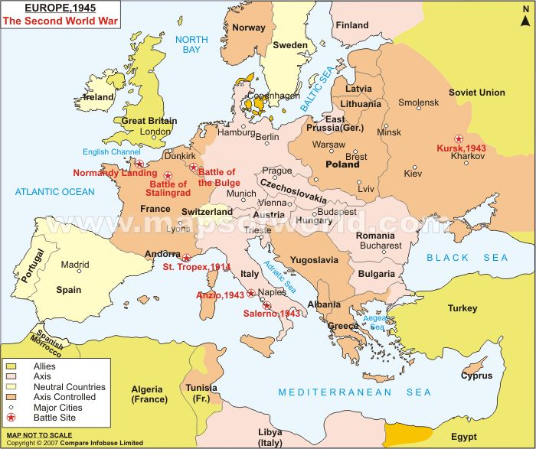
World War II in Europe

Slide 4
WAR IN THE PACIFIC!
Japan immediately invaded the Philippines after pearl harbor. The United States was unable to stop Japanese expansion
Japan formed the “Greater East Asia Co-Prosperity sphere” where Japan would dominate Asia without western influence
United States was able to save Australia from Japan in the Battle of the Coral sea

Slide 5
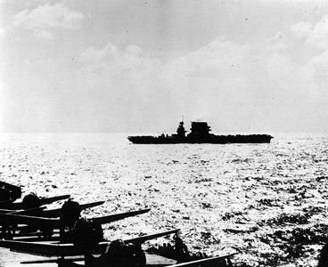
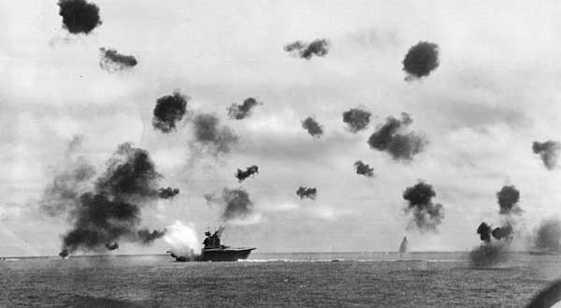

Slide 6
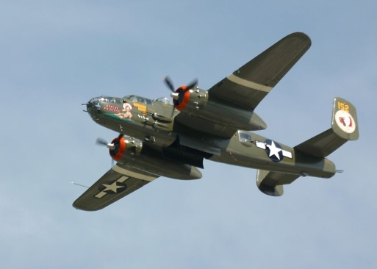
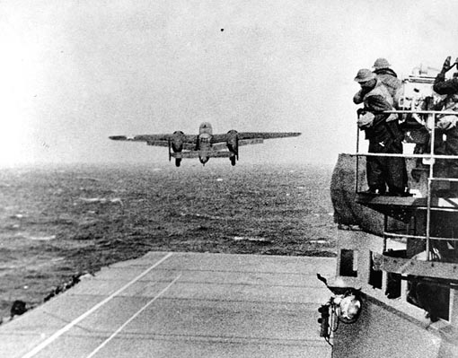
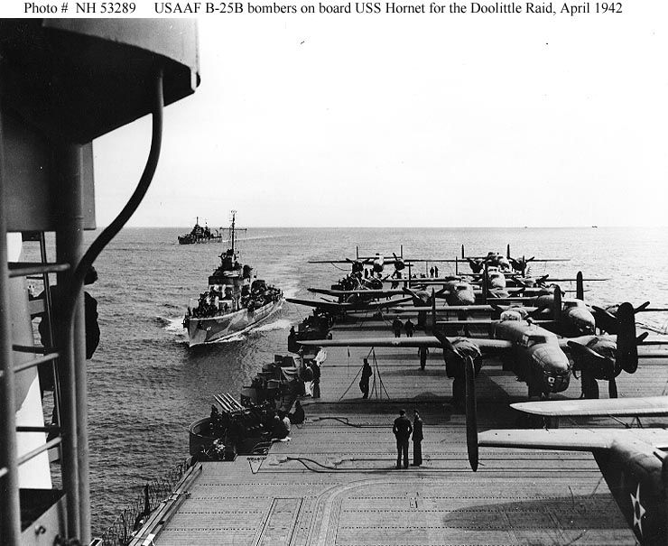
Doolittle Raid
U.S. send B-25 Bombers that are launched from
Aircraft Carriers to attack the Japan. Raid causes little
real damage but a lot of Psychological damage to the
Japanese's.

Slide 7
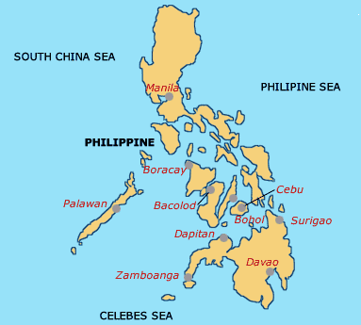
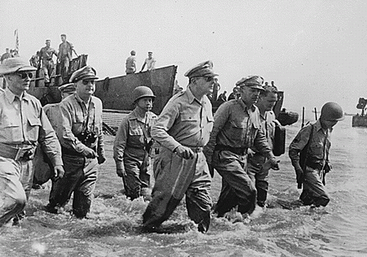
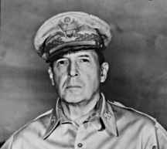
Return to the Philippines – 1944
U.S. returns and kicks the Japanese out.
General Douglas MacArthur promises “I shall return”
To the Philippines people to liberate them from the Japanese.

Slide 8
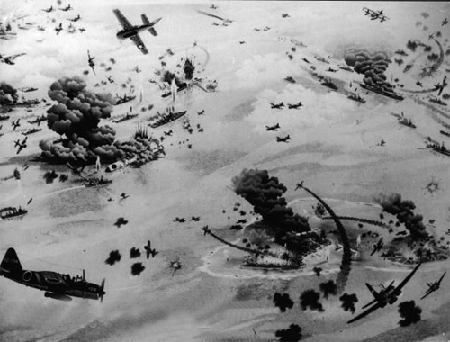
BATTLE OF MIDWAY
Japan sought to destroy remaining U.S. Fleet
Americans had cracked the Japanese code and set a trap
Japanese caught off guard, lost 4 aircraft carriers and naval superiority in the pacific

Slide 9
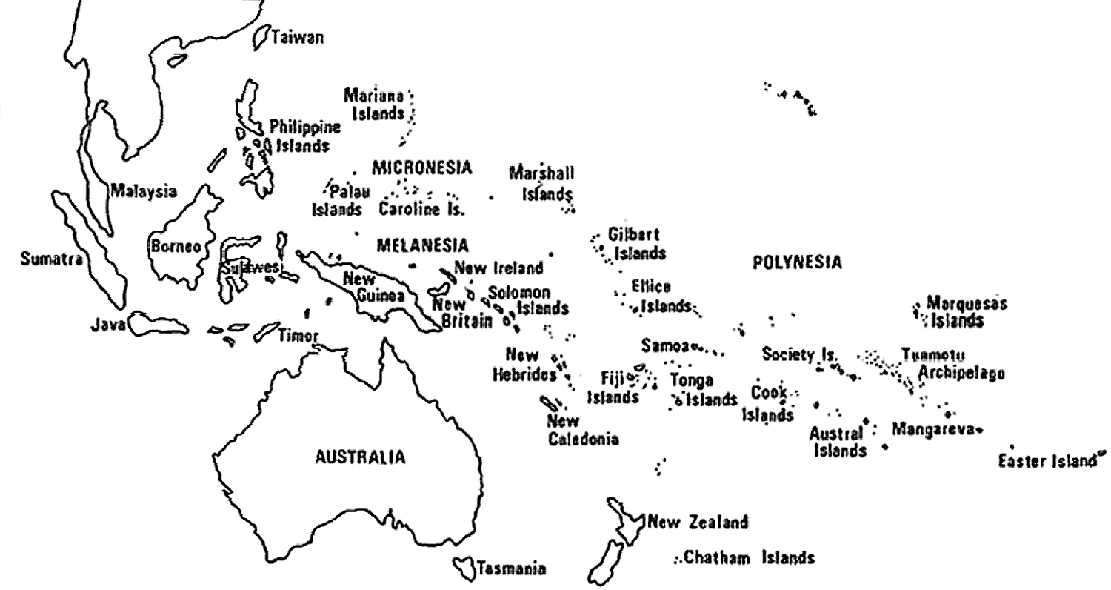
Japanese Strategy for the War
Make surprise attacks and seize as much territory as possible as quickly as possible.
Dig in, and give the Americans the option of a negotiated a peace or a long bloody war.
US Strategy - Island Hopping Campaign-1942-1945
–
U.S. attack weakly defended
islands and by pass others
when possible. This way the U.S.
can get to Japan and
invade Japan with a minimum of causalities

Slide 10
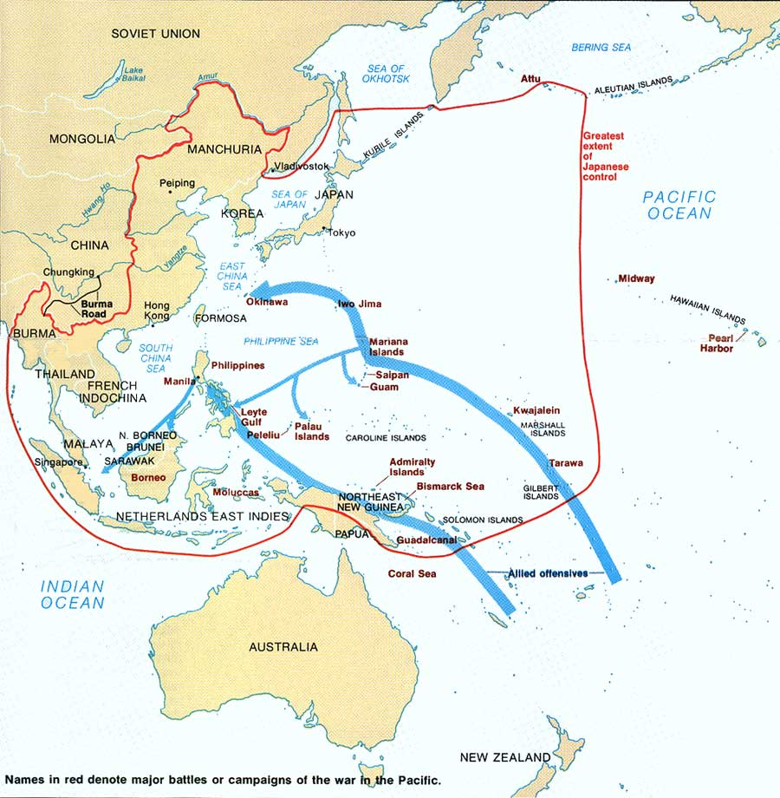
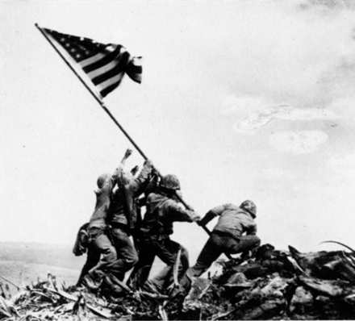

Slide 11
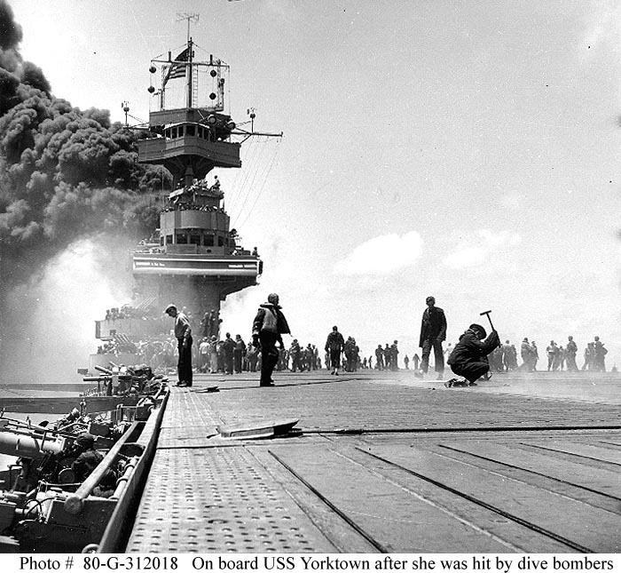

Slide 12
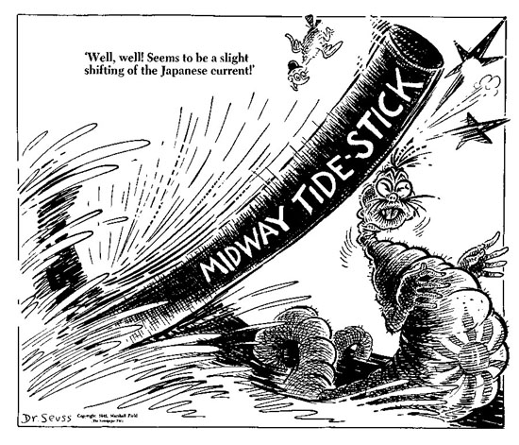

Slide 13
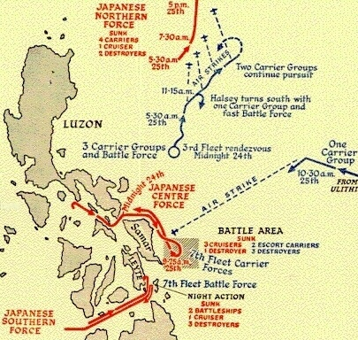
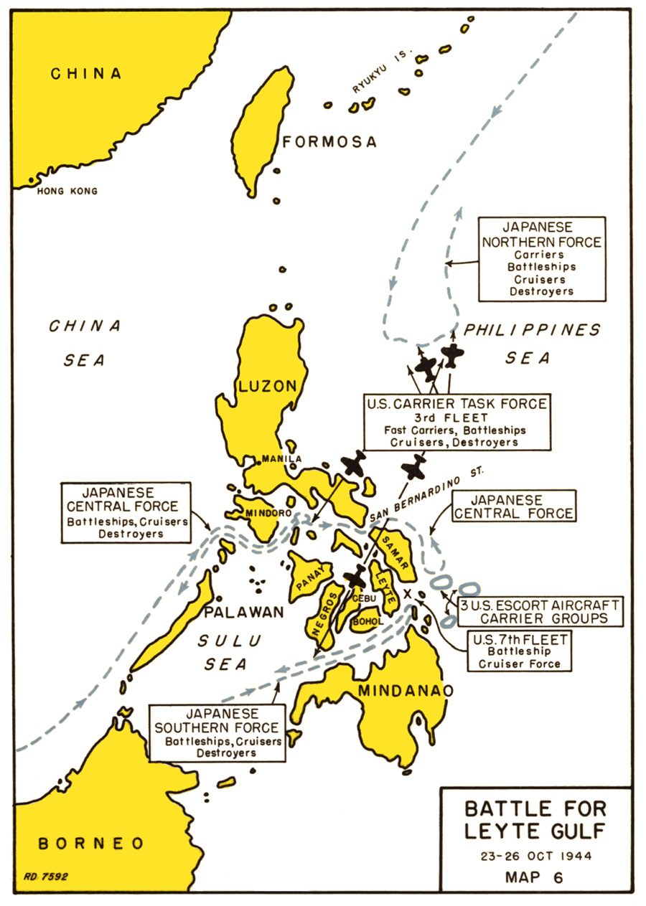
Battle of Leyte Gulf
October 1944
In The Philippines

Slide 14
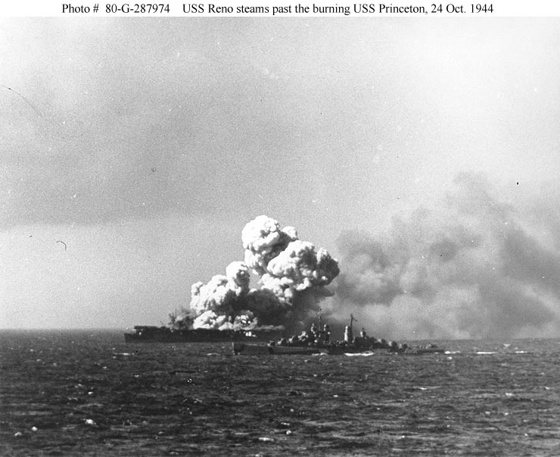
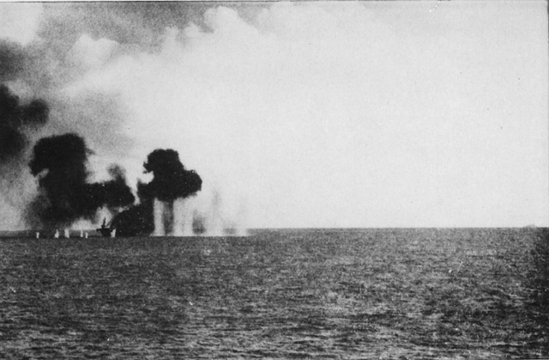
Battle of Leyte Gulf
Japanese Used
Kamikaze Pilots against
American ships
Kamikazes: Suicide pilots
Flying planes into ships

Slide 15
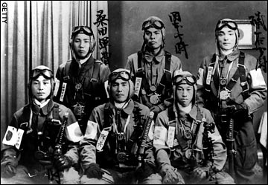
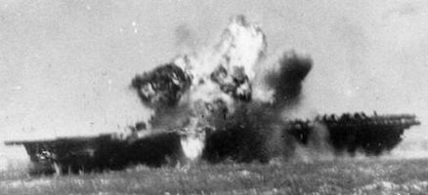
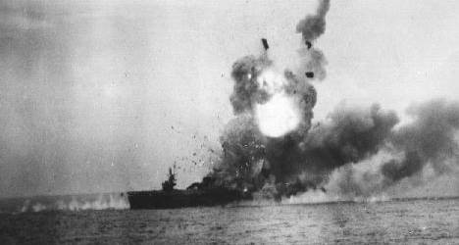
Battle of Leyte Gulf
USA vs. Japan; America wins; wipes out most of Japanese Navy.

Slide 16
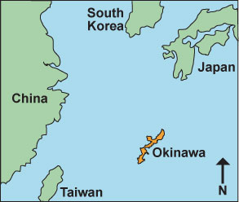
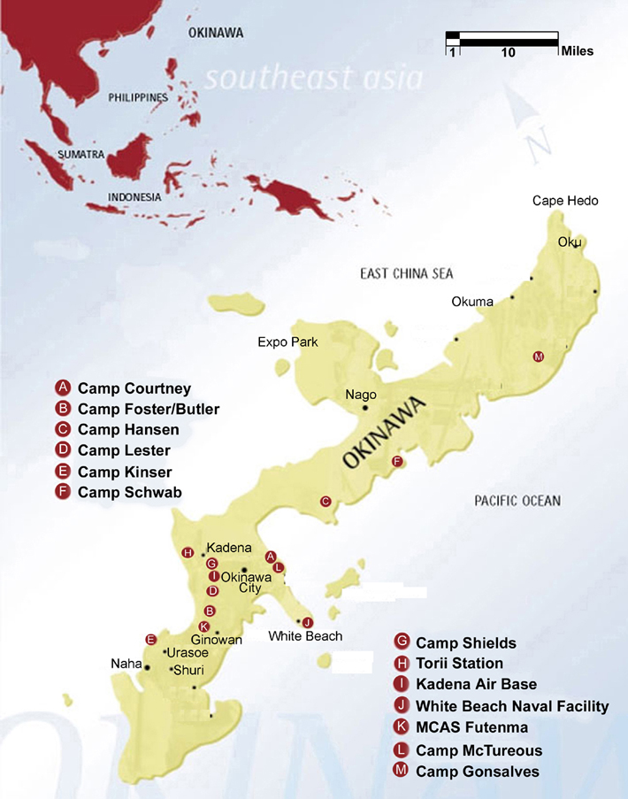
Battle of Okinawa
April 1945;
island 350 miles off the coast of Japan

Slide 17
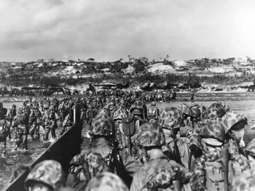
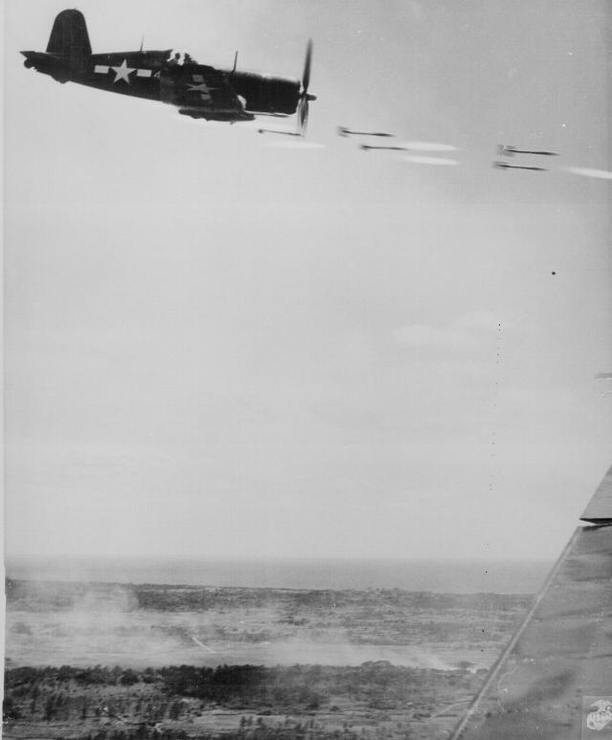
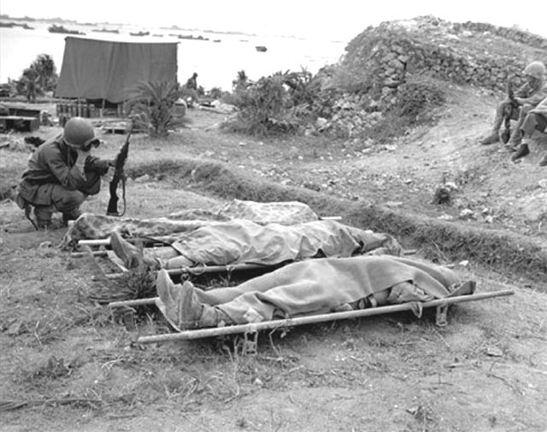
Battle of Okinawa
Japan lost 110,000 – America lost 12,500
moved USA closer to an invasion of Japan to end the war.

Slide 18
Truman faced a choice
Japanese had fought so tenaciously at Okinawa and Iwo Jima some estimates had the U.S. losing over 500,000 soldiers invading Japan
The Manhattan Project: The bomb had been developed in a secret tech race with the Germans and costing billions of dollars.
Truman knew Japanese civilians would be killed

Slide 19
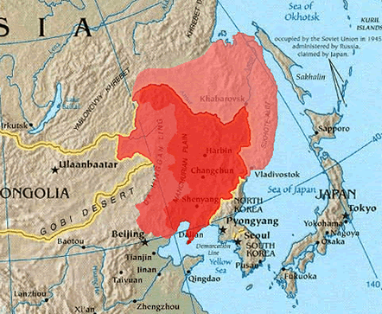
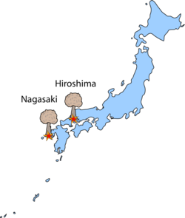
The Japanese would not surrender without their government keeping control
The majority of the Japanese Army (2 Million) was relocating from China to defend Japan
The Soviet Union had been persuaded to assist in attacking Japanese controlled China, but Truman didn’t want them to have communist influence over Japan after the war

Slide 20
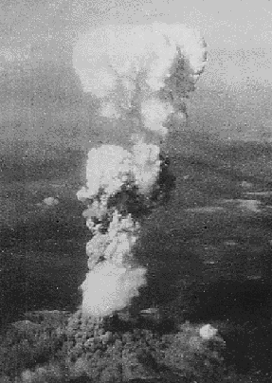
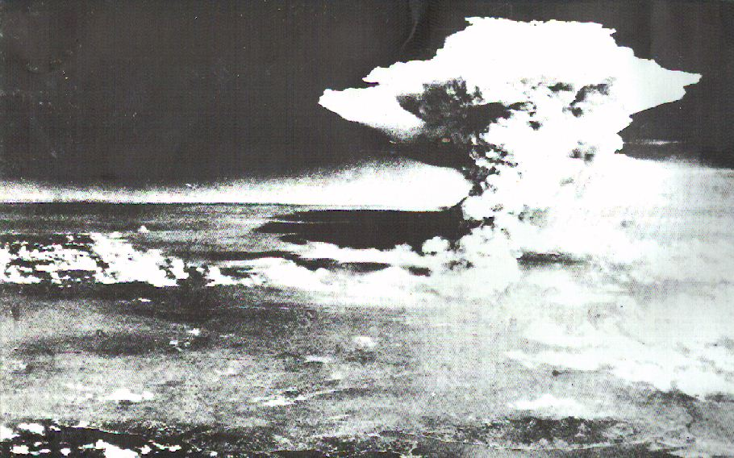
Atomic Bombings of Hiroshima and Nagasaki:

Slide 21
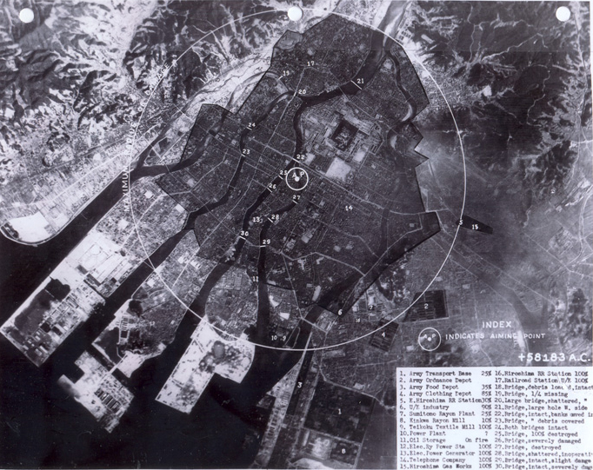
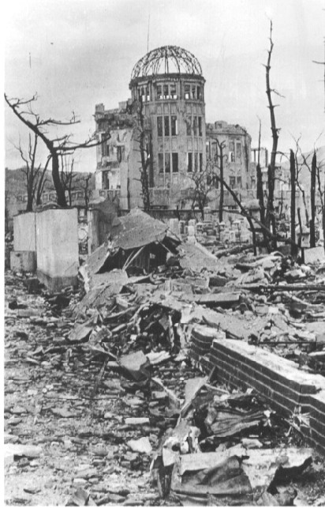
Atomic Bombings of Hiroshima and Nagasaki:

Slide 22
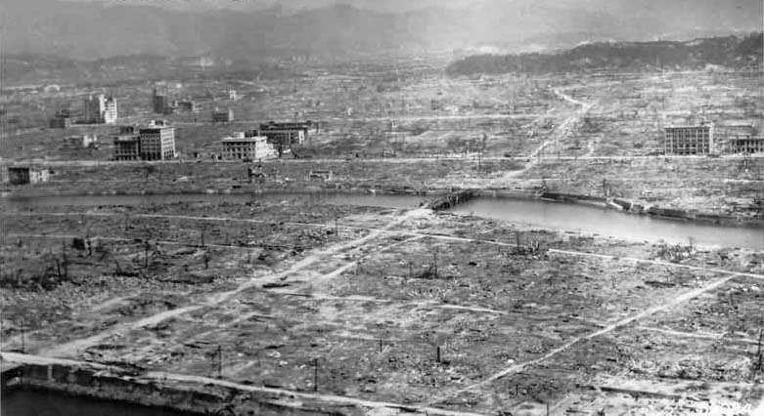
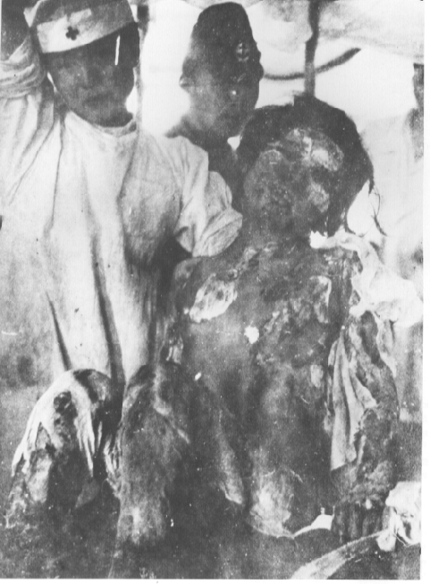
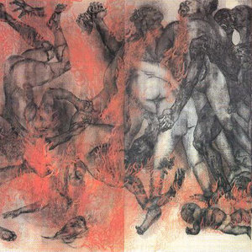
Atomic Bombings of Hiroshima and Nagasaki:

Slide 23
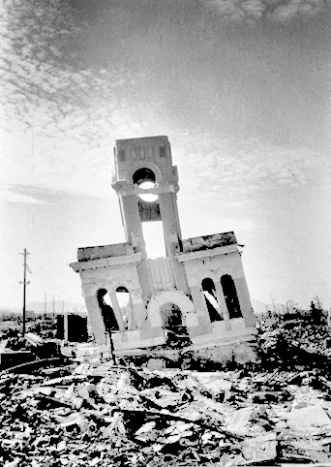
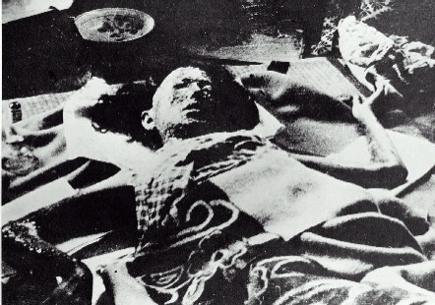
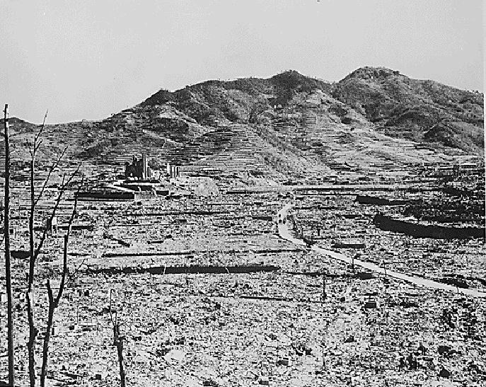
Atomic Bombings of Hiroshima and Nagasaki:

Slide 24
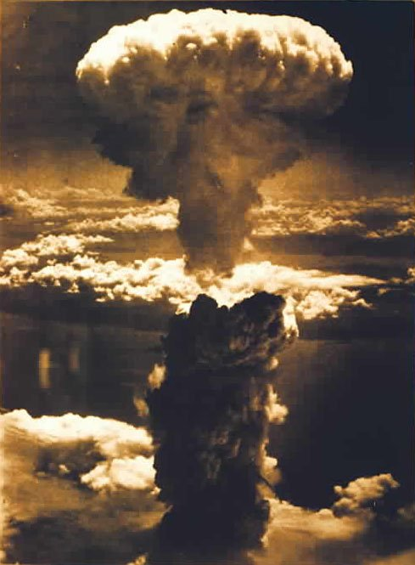
Atomic Bombings of Hiroshima and Nagasaki:
America dropped 2 atomic
(nuclear bombs) on
Japan
August 6, 1945
Hiroshima
bombed: 100,000 killed
August 9, 1945
Nagasaki
bombed:90,000 killed
Forced the surrender of Japan and the end of the war: America never invaded Japan.

Slide 25
Essay Advice
Essential Questions about the use of the A-bomb:
Is it moral to target civilians in a time of war?
How do you weigh the lives of American soldiers vs. the lives of Japanese civilians?
Was the bomb necessary as a military solution?
Although statement
2 quotes from sources

Slide 26
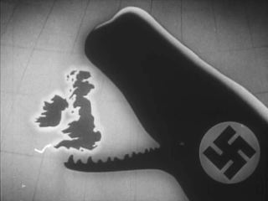
Warm up –Write the Question
In your opinion, what were 2 turning points of the war that caused the Axis to start losing?
Who attended and what occurred at the Tehran conference?

Slide 27
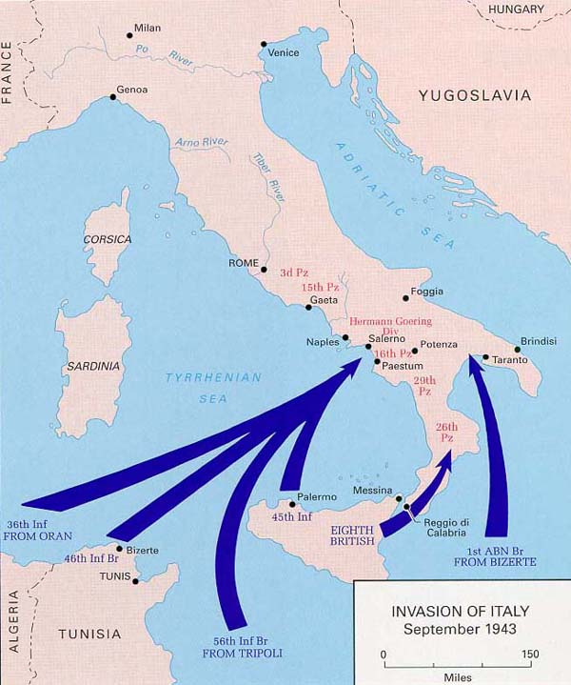
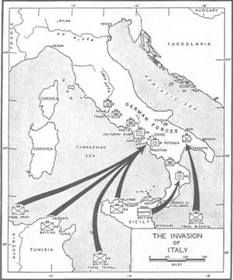
Invasion of Italy
July 1943

Slide 28
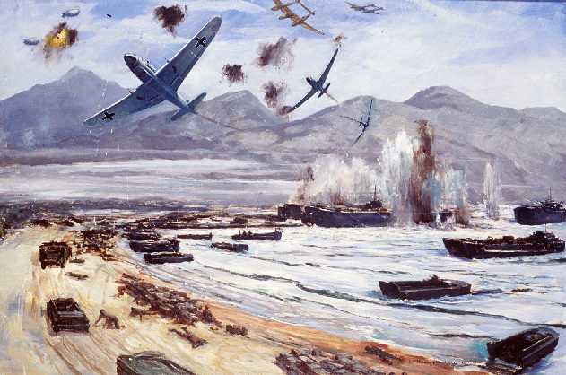
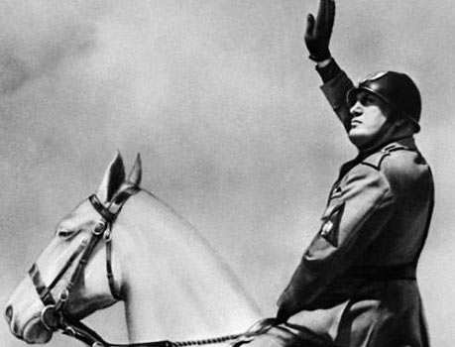
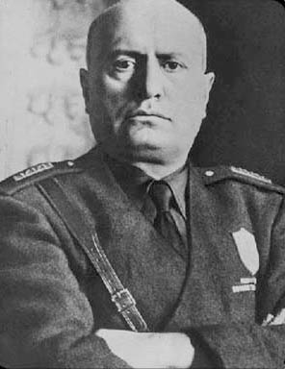
Invasion of Italy
Resulted in Allied conquest of Sicily and eventually all of Italy
Italians overthrow Mussolini and switch sides

Slide 29
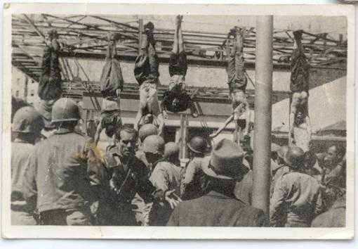
Death of Mussolini

Slide 30
Battle of the Bulge
December 1944
Allies vs. Germany
In Belgium

Slide 31
Battle of the Bulge

Slide 32
Battle of the Bulge
Hitler’s final attempt at victory fails
German offensive forced allies to temporarily retreat
Allies eventually pushed Germans back and caused heavy losses for Hitler

Slide 34
Potsdam
Meeting in a Berlin Suburb to decide how divide a post-Hitler Europe
The Soviet Union would occupy central and Eastern Europe
Truman was worried about Soviet expansion, and warned Stalin about the A-bomb

Slide 35
Is it okay to target civilians and cities in a time of war?

Slide 37
Fall of the Nazis
Fighting a 2 front war, the Nazis gradually retreated back into Germany
Germany simply out produced
The Soviets were the first to make it to Berlin, and taking devastating loses, they captured the city
Hitler committed suicide in a bunker with his wife Eva Braun

Slide 39
END OF WAR
As in WW1, the Russian Army took most of the casualties
The only 2 nations able to stand on their own in the world are the U.S. and Soviet Union, who immediately fall out and start the 46 year long “Cold War”
All the countries that the Soviet Army occupied were denied the free elections Stalin promised
England and France start to lose control of their colonies across the world, leading to an end of the age of imperialism

Slide 41
The competition became known as the “Cold War”…
…and it split the industrialized world in two.

